Slide 1
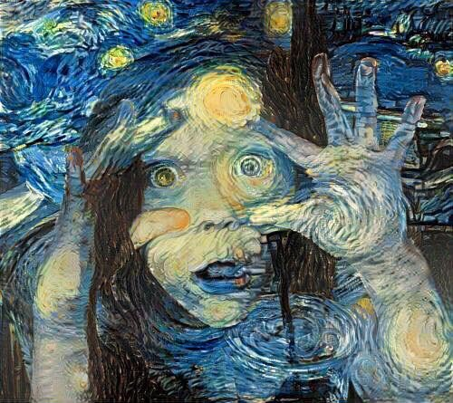
Tzu chi English Educational A lesson on looking – Visual intelligence
Speaking
Being able to express your opinion
Listening
Active Listening with understanding
Creativity
Adding new thoughts to the discussion
Questions
Team Building
Asking poignant questions
Skills Fostered in this Class
Becoming more visually intelligent
Assess the situation
Analyse the details
Articulate what action you will take
Act
Develop a contingency plan
Create a word bank for discussion
Find visual connections where they may not be apparent
Look at something out of context
The real skill is in looking slowly
What people say is as important as what is not said
Seeing what isn’t there is not counter intuitive …. It is a valuable tool
One thought, one idea, one innovation, can alter an approach, change a process and even save lives
Using art to build visual intelligence helps us to understand the big picture and the small details and noticing what is not there.
Christopher Bauman – www.chrisbauman.com.au

Slide 2
1. Looking closely can save a life, help a company to understanding behaviour
____________________________________________________________________________________________?
Advanced Question Words
2. Art is a powerful tool, reframing of where we are and what we see ___________________________________________________________________________________________ ?
We too have the ability to act affirmatively and effect positive change
3. It is possible to see everyday things in a wholly new and eye opening perspective ___________________________________________________________________________________________ ?
How can we train to be more visually intelligent?
4. While looking at a work or art you need to be asking questions about what you see ___________________________________________________________________________________________ ?
Connections
Step beyond the aesthetic value of art
Training the mind
5. So how do we ask the right questions? ___________________________________________________________________________________________ ?
Negative space
6. Learning to frame the question in such a way to elicit the information that we need to do our jobs is a critical skill ___________________________________________________________________________________________ ?
see
Look at the negative spaces
7. Learning how to look at both what is present and absent helps understand emotion and body language ___________________________________________________________________________________________ ?
8. Looking at art gives us a perfect vehicle about how we solve problems without the aid of technology__________________________________________________________________________________ ?
Look for what is apparent
See the extraordinary in the everyday, articulate what is absent and be able to inspire creativity and innovation and most importantly forge human connections where they may not be apparent… and see the world at large with a new set of eyes
Christopher Bauman – www.chrisbauman.com.au

